Slide 1
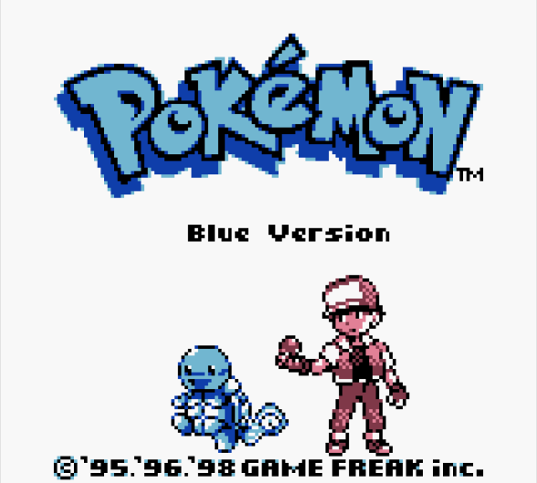
Progress Report 2
Edesia: System/Algorithm Design and Analysis
Team Blue
Adam Bowers | Daniel Wingo | Stephen Bennett | Jonathan Holley
Github: aLotofAdam | 81wingo | stephenbennett2 | mccauley747
UNCG: ajbower3 | dtwingo | scbenne3 | jbholley

Slide 2
Detailed Design and Controls

Slide 3
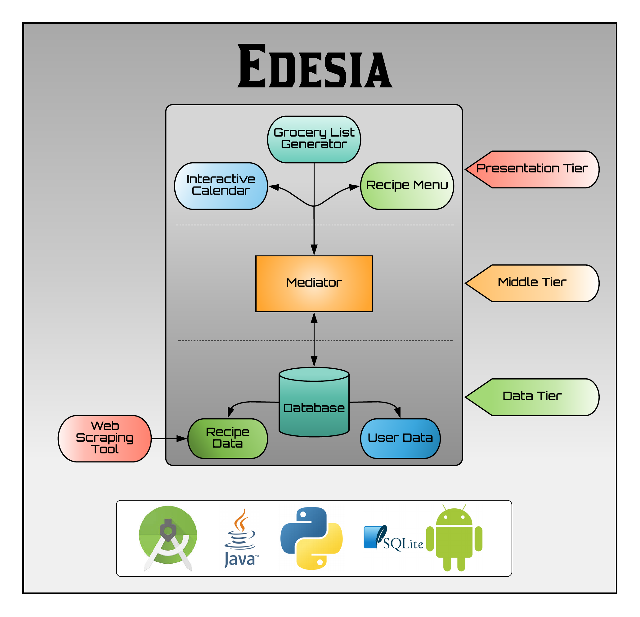
System Model:
3-Tier Architecture
Presentation Tier:
User interfaces
Middle Tier:
Process commands
Moves data between layers
Coordinates application
Data Tier:
Stores data

Slide 4
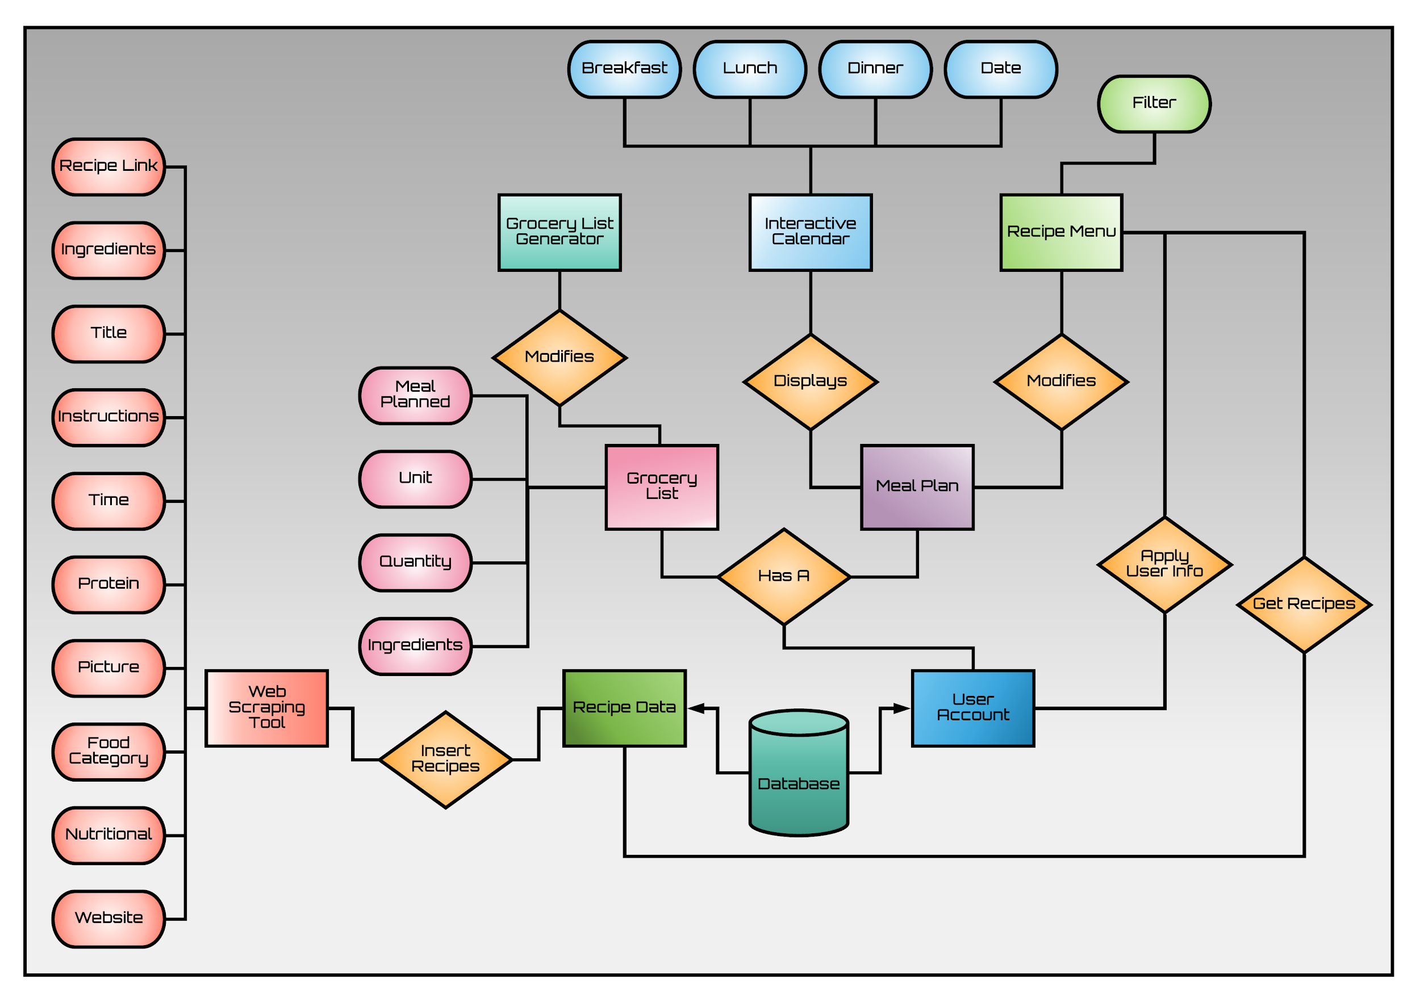
System ER Diagram

Slide 5
Amended Models

Slide 6
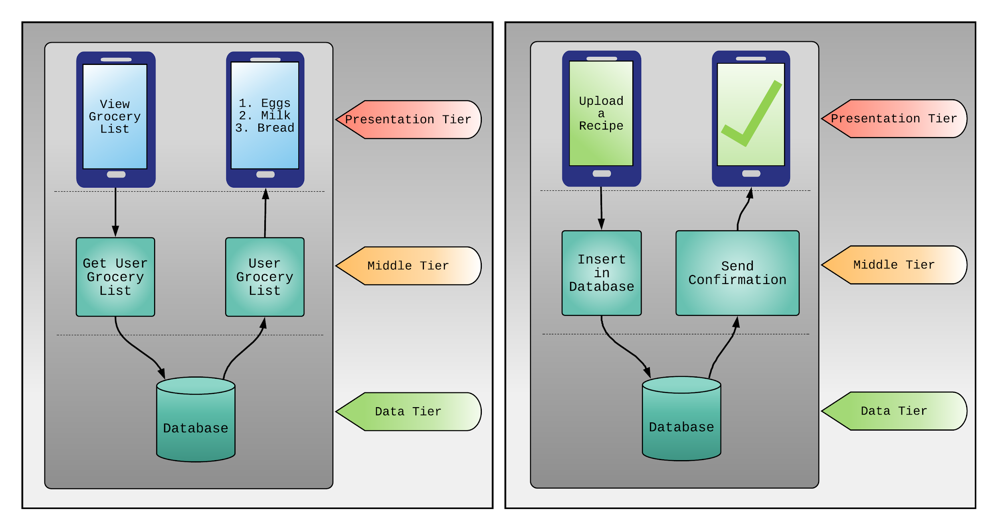
Process Models

Slide 7
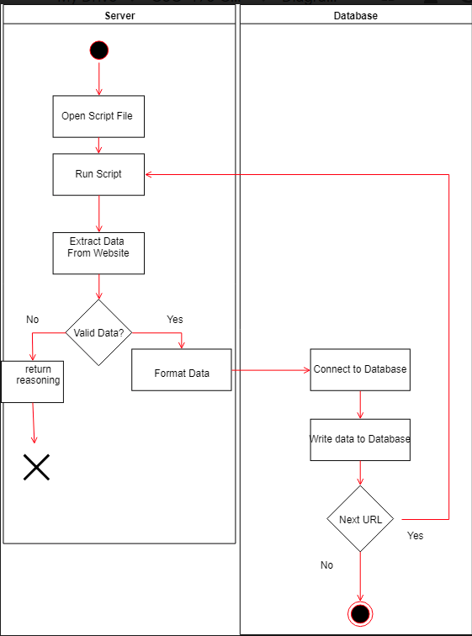
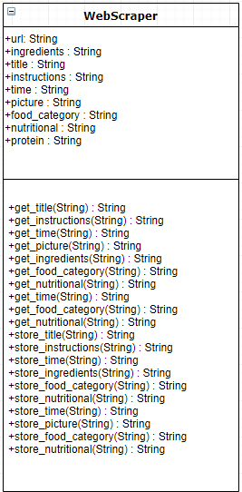
Class Diagram Activity Diagram
Web Scraper

Slide 8
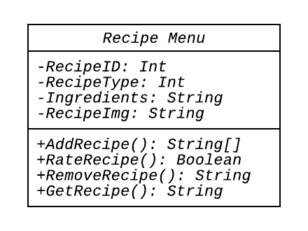
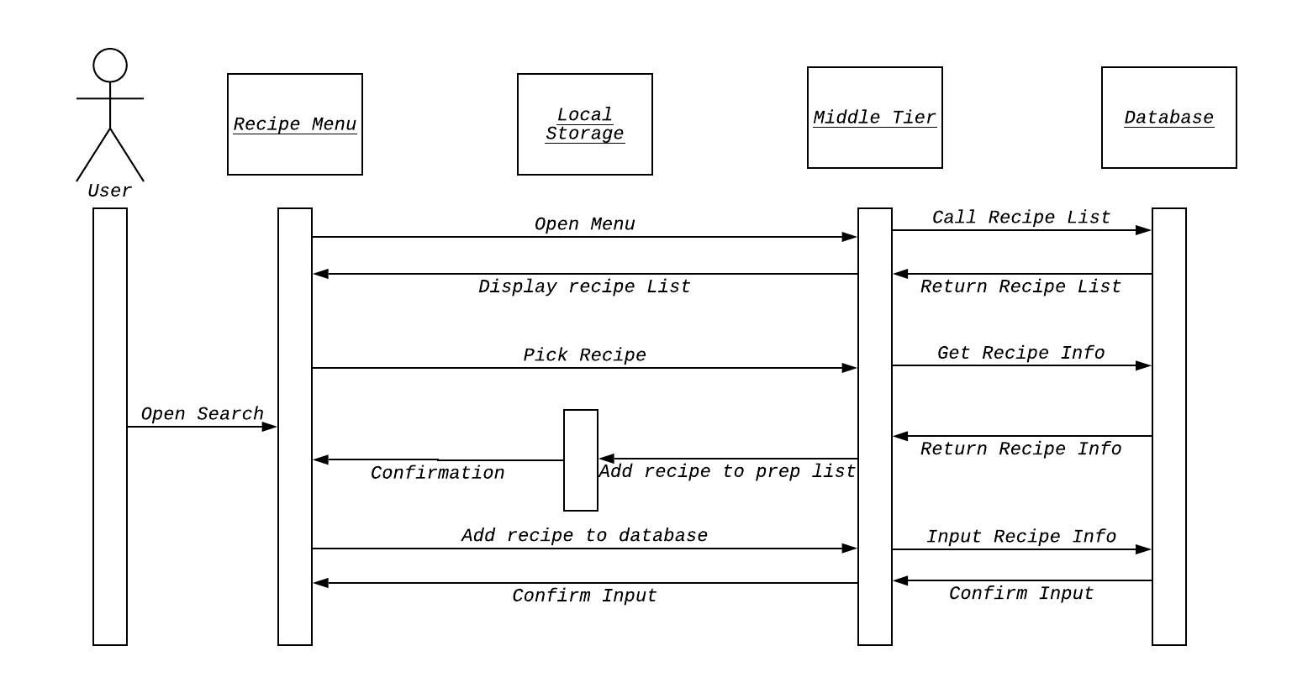
Recipe Menu
Class Diagram Sequence Diagram

Slide 9
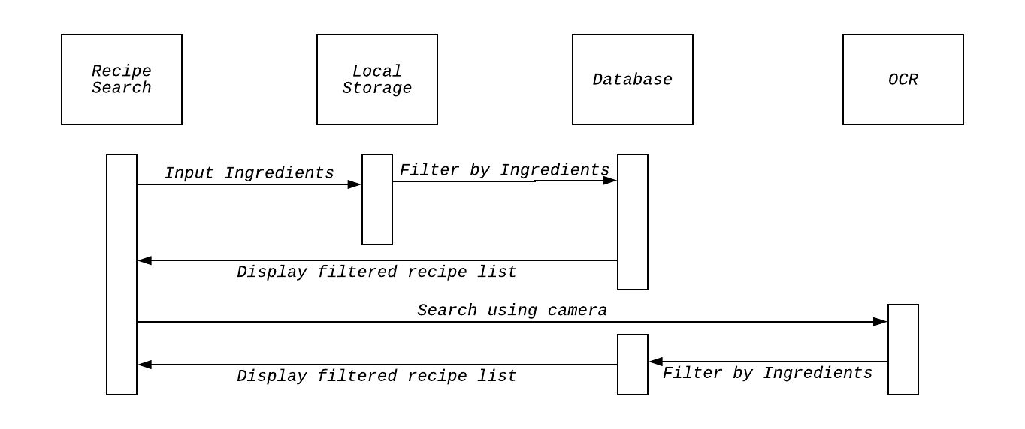
Recipe Based on Ingredients available

Slide 10
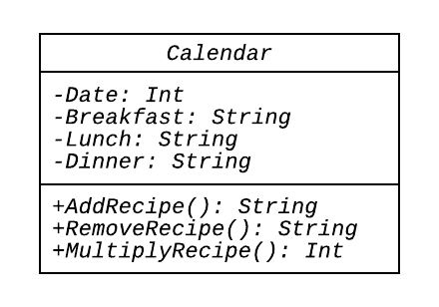
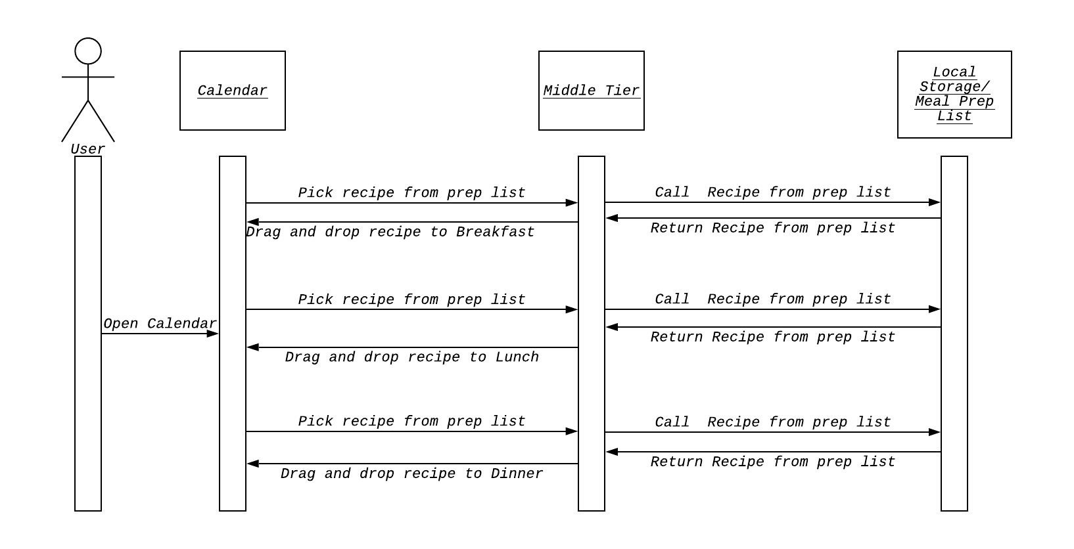
Calendar
Class Diagram Sequence Diagram

Slide 11
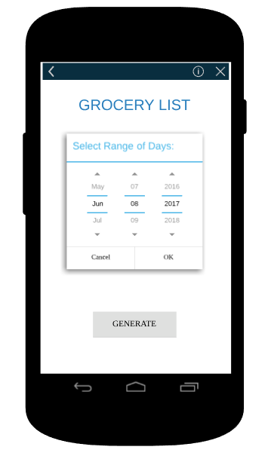
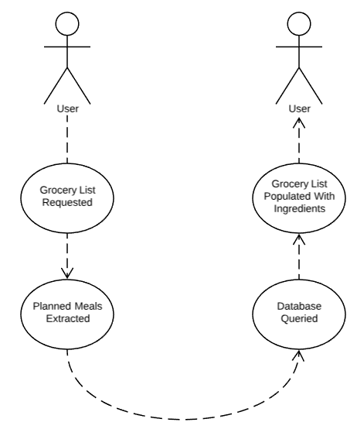
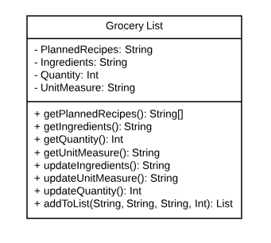
Grocery List Generator
Mockup Use Case Class Diagram

Slide 12
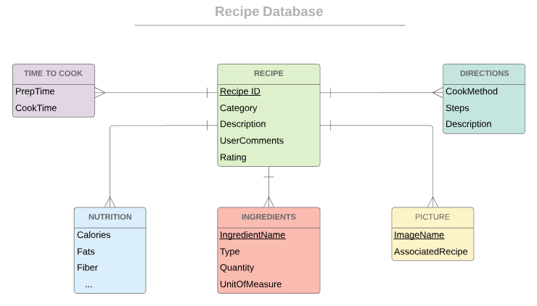
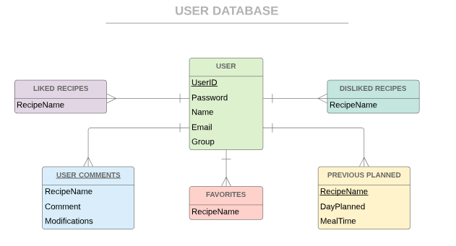
Database ER

Slide 13
Systems/Algorithm Analysis

Slide 14
Algorithm Analysis
The web scraper we are more worried about accuracy versus speed. But to insert the data it will be O(1).
SQLite Database uses a B-Tree so the time complexity is O(log n) for insert, delete and search of database(s).
The Recipe Search will be limited by the database so it should also have a time complexity of O(log n).

Slide 15
Data Dictionary

Slide 16
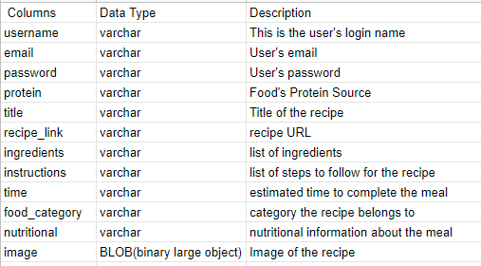
Data Dictionary Format

